Slide 1
PROJECT:
Analysing the sales of a coffee shop franchise

Slide 2
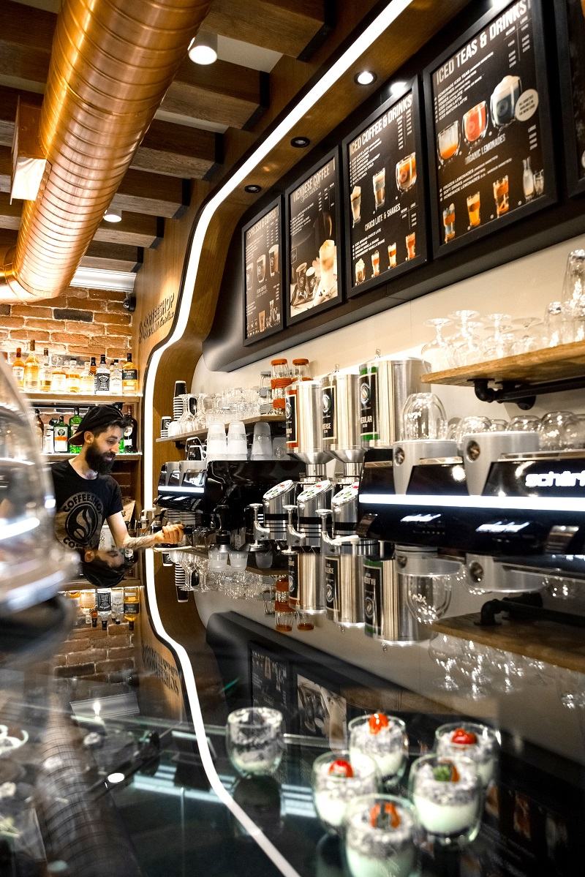
A simple scenario
We are given some data from a coffee shop franchise.
They want us to find any patterns possible that can be utilised in the future, to increase overall sales.
Additionally, any other insights would be deemed as valuable information.

Slide 3
STEP 1
Gathering the Data

Slide 4
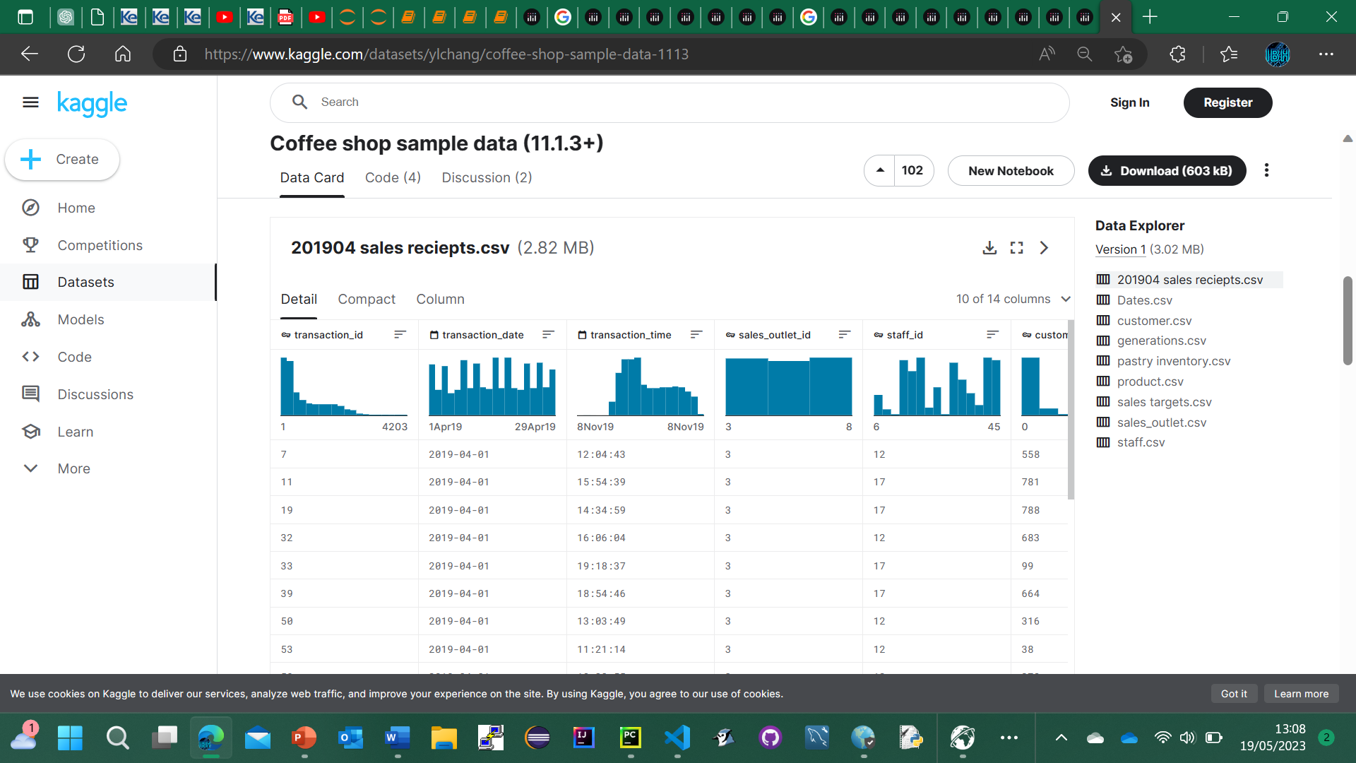
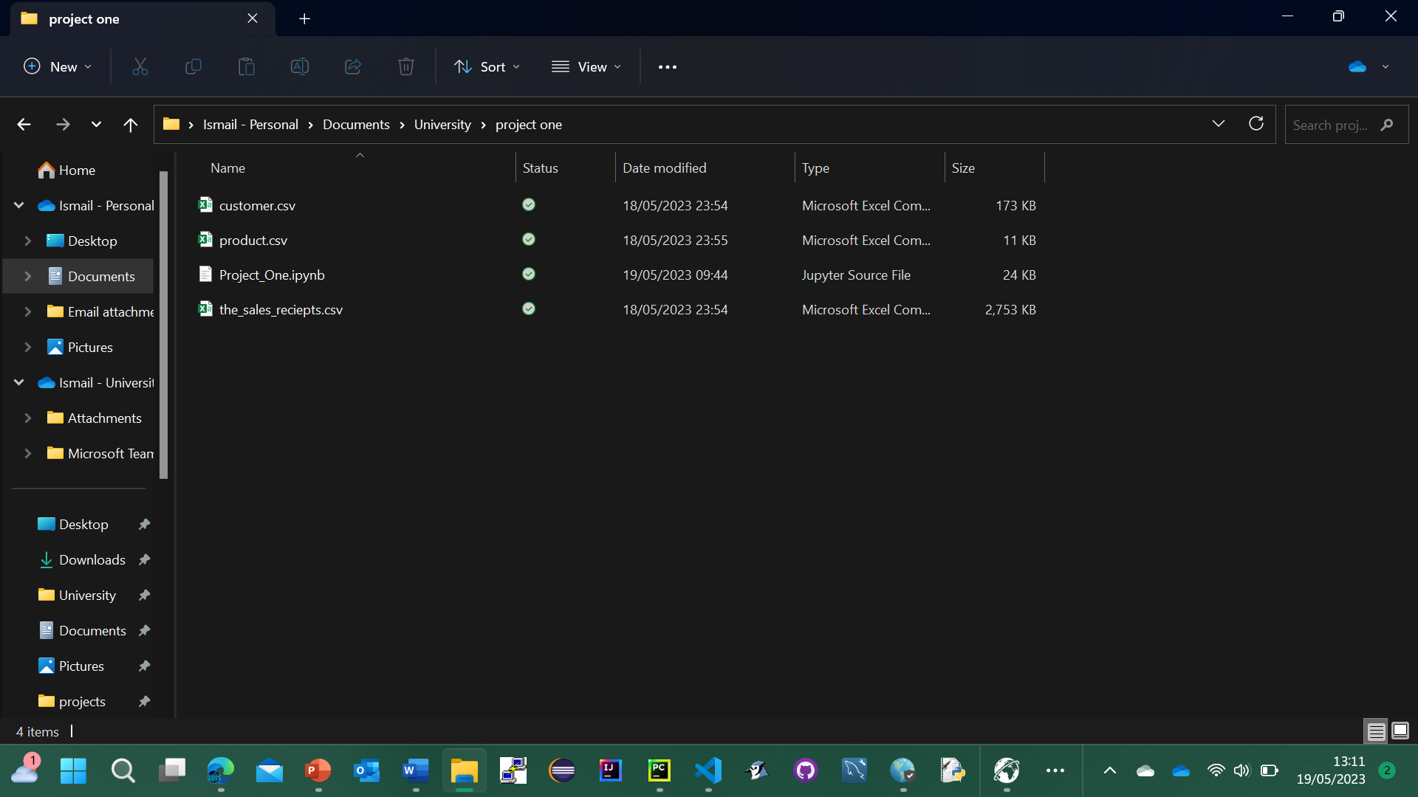
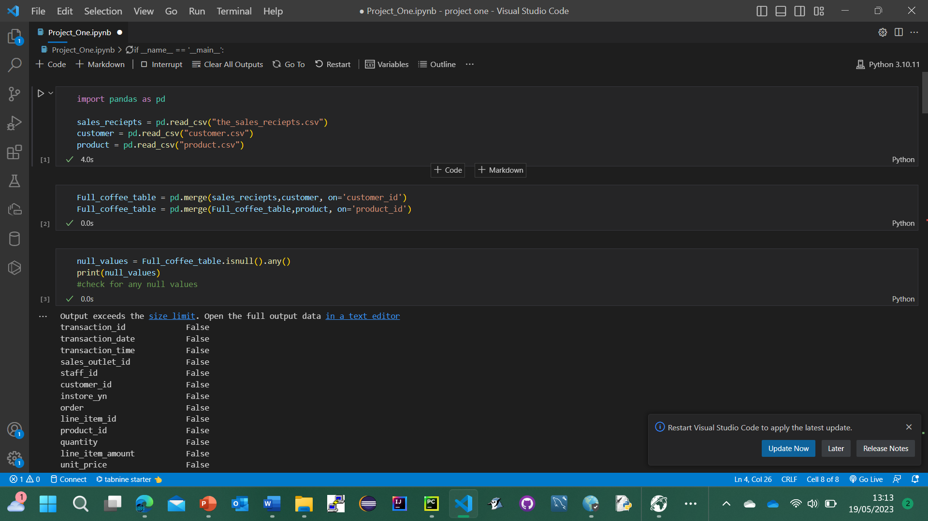
Identify and download the relevant datasets as csv files
Raw data
Use the csv’s by using pandas

Slide 5
STEP 2
Cleaning and formatting the data

Slide 6
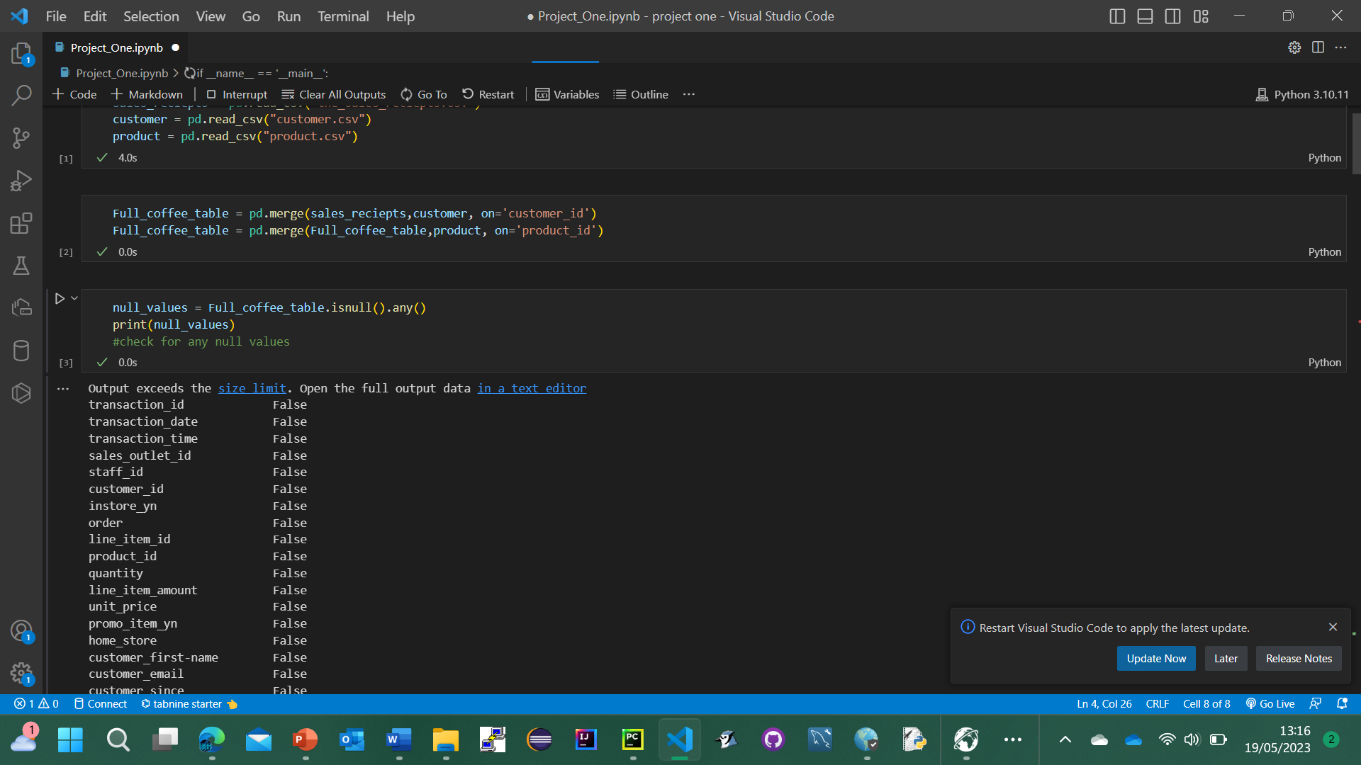
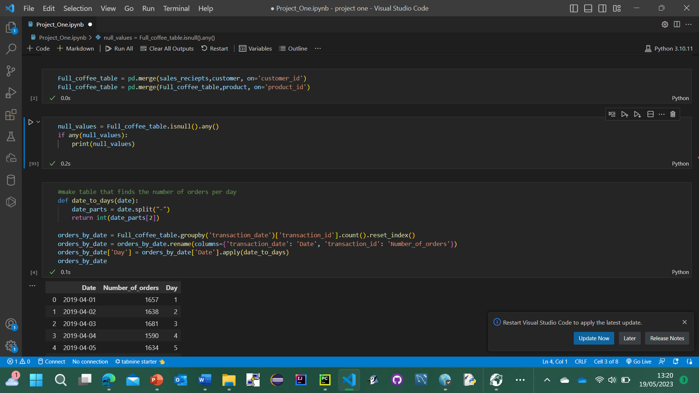
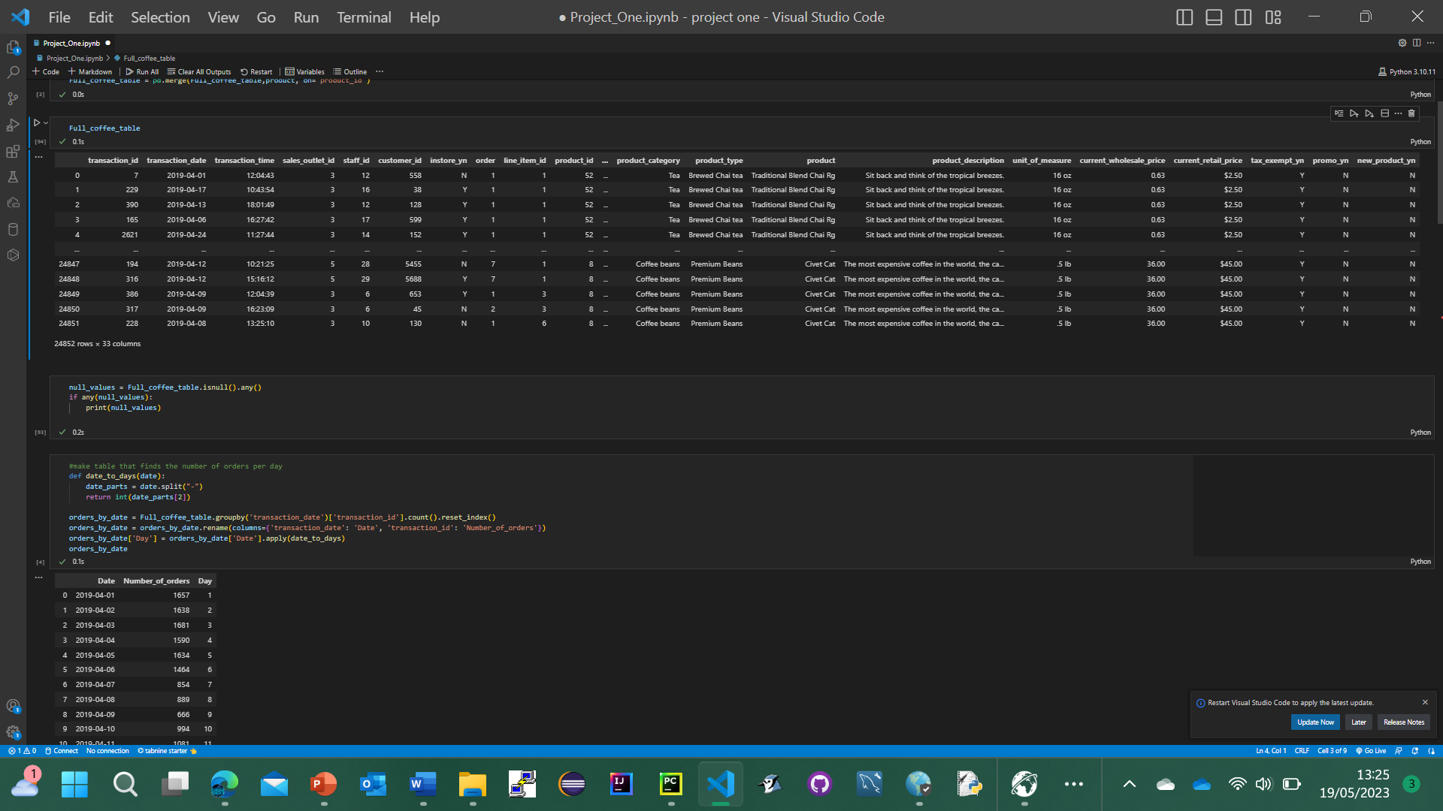
1 Merge all the data
2 Check the data for null values
3 Check the merged dataframe ‘Full _coffee_table ‘

Slide 7
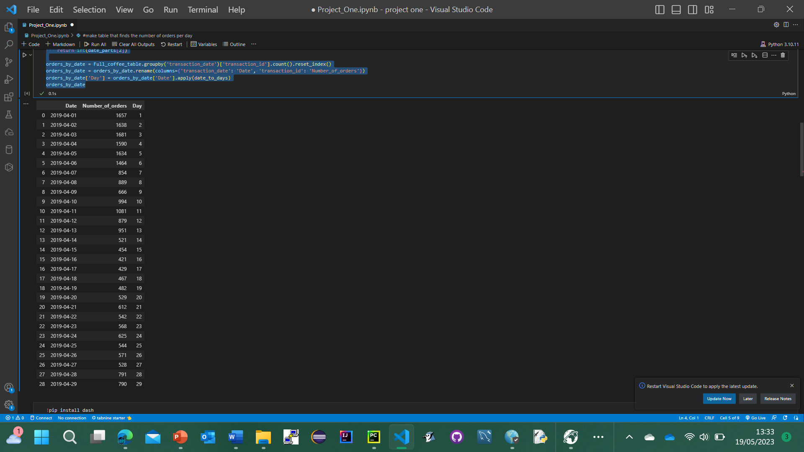
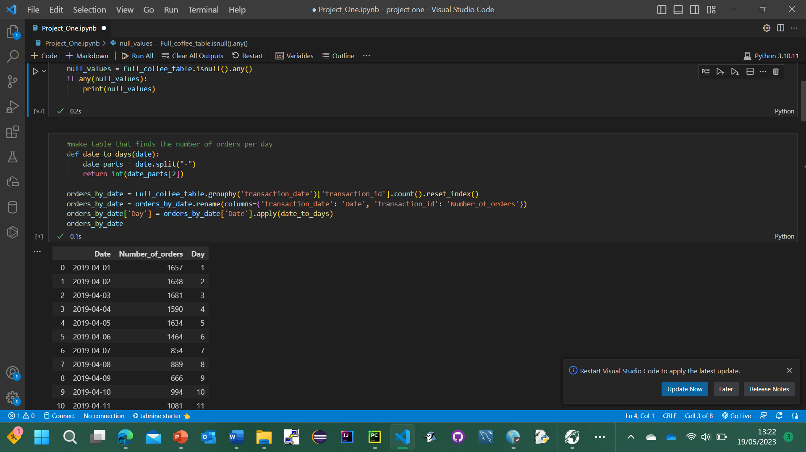
4 Make a new dataframe called orders_by_date only using the relevant data

Slide 8
STEP 3
Apply data analysis

Slide 9
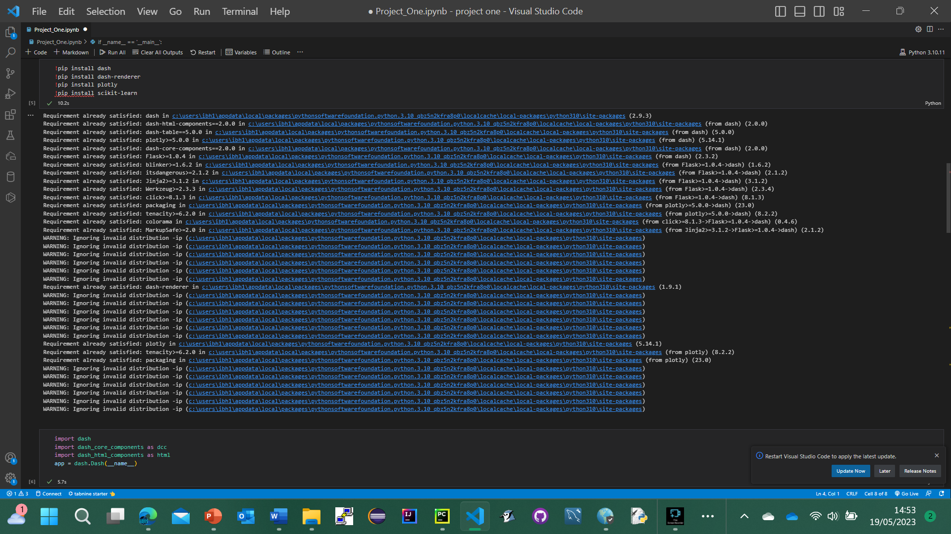
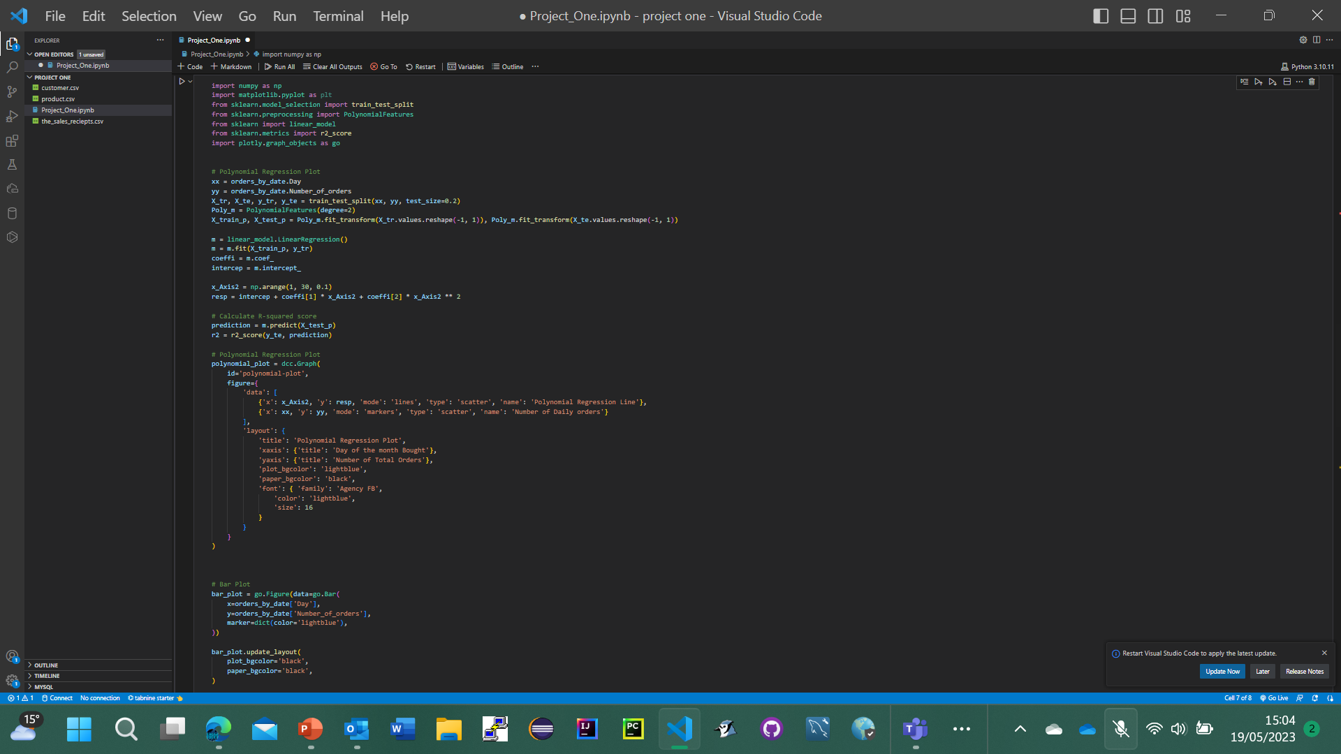

Slide 10
STEP 4
Interpret the results

Slide 11
We can use a polynomial curve to visualise the relationship, before applying an r2score which gives an accuracy for this curve.
R2score: 83%
This suggests there is a relevant correlation present

Slide 12
STEP 5
Visualise the data

Slide 13
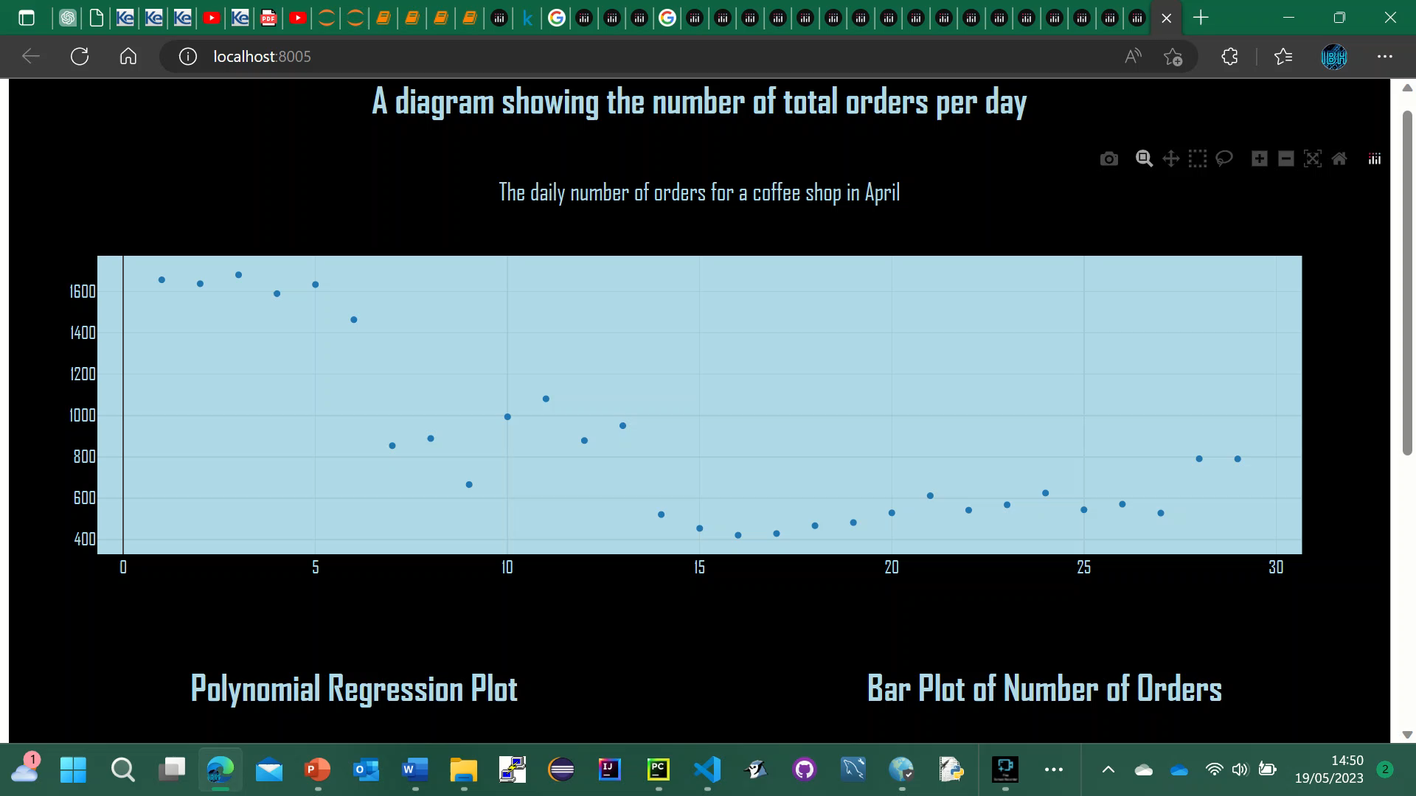

Slide 14
STEP 5
Draw insights

Slide 15
As time progresses from the first day of the month in April, to the last day of the month, an overall decrease in sales can be interpreted.
This correlation can be seen visually, and by observing the r2 score.
To determine why this is the case, further investigation can be employed to investigate areas such as:
An observation of the weather on each day
Whether or not sales increased on the weekends or not
What new products were launched during this month
Did the number of customer complaints increase over this time period
Was there an increase in sales during special events such as Easter
And so on..

